Slide 1
Algorithms

Slide 2
Backtracking
Suppose you have to make a series of decisions, among various choices, where
You don’t have enough information to know what to choose
Each decision leads to a new set of choices
Some sequence of choices (possibly more than one) may be a solution to your problem
Backtracking is a methodical way of trying out various sequences of decisions, until you find the correct one that “works”.

Slide 3
Backtracking
Backtracking is used to solve problems in which a sequence of objects is chosen from a specified set so that the sequence satisfies some criterion.
Backtracking is a modified depth-first search of a tree.
It is the procedure whereby, after determining that a node can lead to nothing but dead nodes, we go back (“backtrack”) to the node’s parent and proceed with the search on the next child.

Slide 4
Backtracking (animation)
dead end
?
dead end
dead end
?
start
?
?
dead end
dead end
?
success!
Notes:
4

Slide 5
Backtrack Algorithm
Based on depth-first recursive search
Approach
Tests whether solution has been found
If found solution, return it
Else for each choice that can be made
Make that choice
Recursive
If recursion returns a solution, return it
If no choices remain, return failure
Some times called “search tree”

Slide 6
Backtracking examples
Backtracking can be used in this cases:
Solving a maze
Coloring a map
N queens problem etc.,

Slide 7
8 Queens Problem
The 8-queens problem is a classical combinatorial problem in which it is required to place eight queens on an 8 x 8 chessboard so no two can attack each other.
A queen can attack another queen if it exists in the same row, column or diagonal as the queen.
If number of queens is fixed and there can't be more than one queen per column so we can iterate through the rows for each column
7

Slide 8
A Solution to 8 Queens
for(int c0 = 0; c0 < 8; c0++){
board[c0][0] = 'q'; for(int c1 = 0; c1 < 8; c1++){
board[c1][1] = 'q';
for(int c2 = 0; c2 < 8; c2++){
board[c2][2] = 'q';
// a little later
for(int c7 = 0; c7 < 8; c7++){
board[c7][7] = 'q'; if( queensAreSafe(board) ) printSolution(board);
board[c7][7] = ' '; //pick up queen } board[c6][6] = ' '; // pick up queen
8

Slide 9
Backtracking – Eight Queens Problem
The problem with N queens is you don't know how many for loops to write
The neat thing about coding up backtracking, is that it can be done recursively, without having to do all the bookkeeping at once.
Instead, the stack or recursive calls does most of the bookkeeping
(I e, keeping track of which queens we've placed, and which combinations we've tried so far, etc.)

Slide 10

Backtracking – Eight Queens Problem
The backtracking strategy is as follows:
Place a queen on the first available square in row 1.
Move onto the next row, placing a queen on the first available square there (that doesn't conflict with the previously placed queens).
Continue in this fashion until either:
you have solved the problem, or
you get stuck.
When you get stuck, remove the queens that got you there, until you get to a row where there is another valid square to try.
Q
Q
Q
Q
Q
Q
Continue…
Animated Example:
http://www.hbmeyer.de/backtrack/achtdamen/eight.htm#up

Slide 11
perm[] - stores a valid permutation of queens from index 0 to location-1.
location – the column we are placing the next queen
usedList[] – keeps track of the rows in which the queens have already been placed.
void solveItRec(int perm[], int location, struct onesquare usedList[]) {
if (location == SIZE) {
printSol(perm);
}
for (int i=0; i<SIZE; i++) {
if (usedList[i] == false) {
if (!conflict(perm, location, i)) {
perm[location] = i;
usedList[i] = true;
if( solveItRec(perm, location+1, usedList))
usedList[i] = false;
}
}
}
}
Found a solution to the problem, so print it!
Loop through possible rows to place this queen.
Only try this row if it hasn’t been used
Check if this position conflicts with any previous queens on the diagonal
mark the queen in this row
mark the row as used
solve the next column location recursively
un-mark the row as used, so we can get ALL possible valid solutions.

Slide 12
Greedy Algorithm

Slide 13
The Knapsack Problem
A thief breaks into a museum. Fabulous paintings, sculptures, and jewels are everywhere. The thief has a good eye for the value of these objects, and knows that each will fetch hundreds or thousands of dollars on the clandestine art collector’s market. But, the thief has only brought a single knapsack to the scene of the robbery, and can take away only what he can carry. What items should the thief take to maximize the haul?

Slide 14
The Knapsack Problem
The 0-1 knapsack problem:
The thief must choose among n items, where the i^{th} item worth v_{i} dollars and weighs w_{i} pounds
Carrying at most W pounds, maximize value
v_{i}, w_{i}, and W are all integers
“0-1” each item must be taken or left in entirety
The fractional knapsack problem:
Thief can take fractions of items
Think of items in 0-1 problem as gold ingots, in fractional problem as buckets of gold dust

Slide 15
The Knapsack Problem and Optimal Substructure
Both variations exhibit optimal substructure
To show this for the 0-1 problem, consider the most valuable load weighing at most W pounds
If we remove item j from the load, what do we know about the remaining load?
A: remainder must be the most valuable load weighing at most W - w_{j} that thief could take from museum, excluding item j
Fractional Knapsack
Consider optimal load of weight W
If we remove weight w of item j , the remaining load is the optimal load weighing W-w that the thief can take from the original n-1 original items plus w_{j} - w pounds of item j

Slide 16
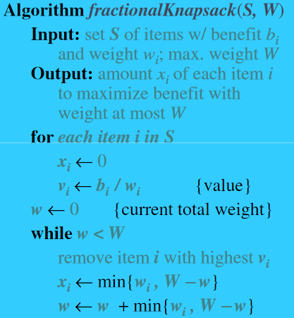

Slide 17
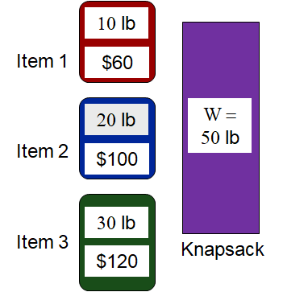
Fractional KS Using Greedy
What is the greedy selection criterion?
Pick the heaviest item first?
Pick the lightest item first?
Greedy strategy: take in order of dollars/pound (benefit/weight)
benefit/weight = [6, 5, 4]
Fractional KS:
Optimal Solution = [1, 1, 2/3]
Total benefit = 60 + 100 + 120*(2/3) = 240
0/1 KS:
Optimal Solution = [1, 1, 0]
Total benefit = 60 + 100 = 160
Greedy doesn’t work for 0/1 KS

Slide 18
Excercise
Q1. Find the optimal solution to the following knapsack instance
No. of items n=8
KS capacity W = 16
Profit (p1, p2 …. p8) = (10, 8, 5, 15, 7, 6, 18, 3)
Weight (w1,w2….. w8) = (2, 4, 3, 5, 7, 1, 4, 1)
Q2. You are studying for an exam and you have to study N questions. The questions take {t1, t2, t3,…., tn} time(in hours) and carry {m1, m2, m3,…., mn} marks. You can study for a maximum of T hours. You can either study a question or leave it. Choose the questions in such a way that your score is maximized. Provide a solution.

Slide 19
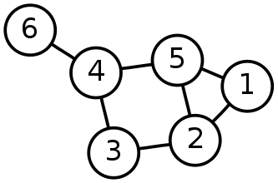
Single-Source Shortest Path Problem
Single-Source Shortest Path Problem - The problem of finding shortest paths from a source vertex v to all other vertices in the graph.

Slide 20
Dijkstra's algorithm
Dijkstra's algorithm - is a solution to the single-source shortest path problem in graph theory.
Works on both directed and undirected graphs. However, all edges must have nonnegative weights.
Approach: Greedy
Input: Weighted graph G={E,V} and source vertex v∈V, such that all edge weights are nonnegative
Output: Lengths of shortest paths (or the shortest paths themselves) from a given source vertex v∈V to all other vertices

Slide 21
Dijkstra's algorithm - Pseudocode
dist[s] ←0 (distance to source vertex is zero) for all v ∈ V–{s} do dist[v] ←∞ (set all other distances to infinity) S←∅ (S, the set of visited vertices is initially empty) Q←V (Q, the queue initially contains all vertices) while Q ≠∅ (while the queue is not empty) do u ← mindistance(Q,dist) (select the element of Q with the min. distance) S←S∪{u} (add u to list of visited vertices) for all v ∈ neighbors[u] do if dist[v] > dist[u] + w(u, v) (if new shortest path found) then d[v] ←d[u] + w(u, v) (set new value of shortest path)
(if desired, add traceback code)
return dist

Slide 22
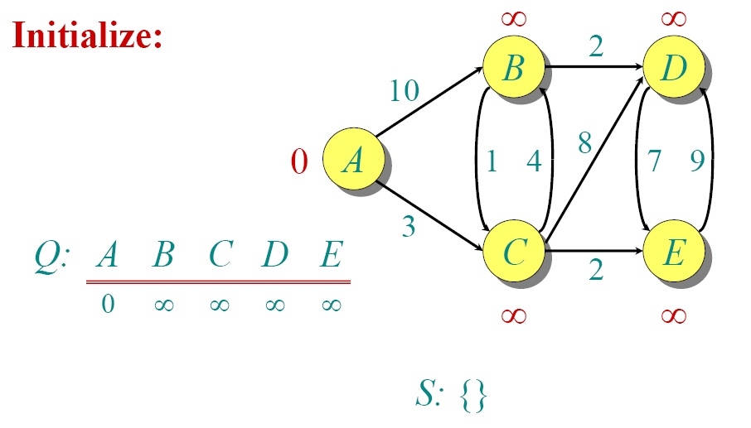
Dijkstra Animated Example

Slide 23
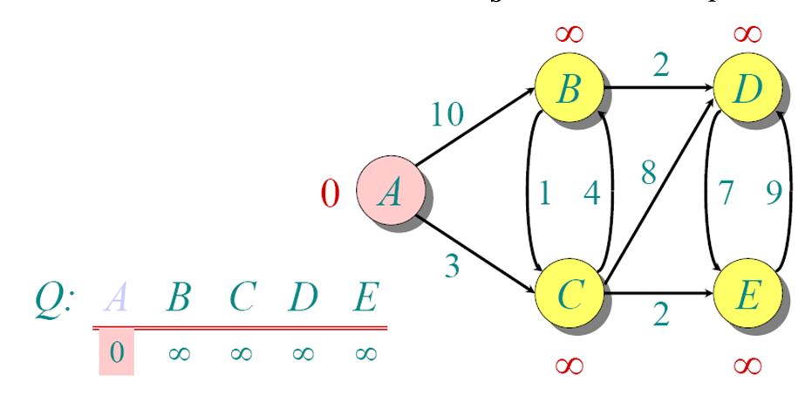
Dijkstra Animated Example

Slide 24
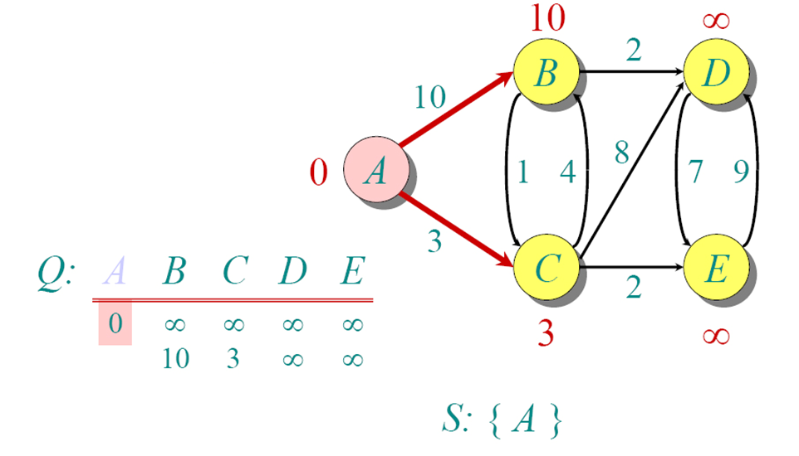
Dijkstra Animated Example

Slide 25
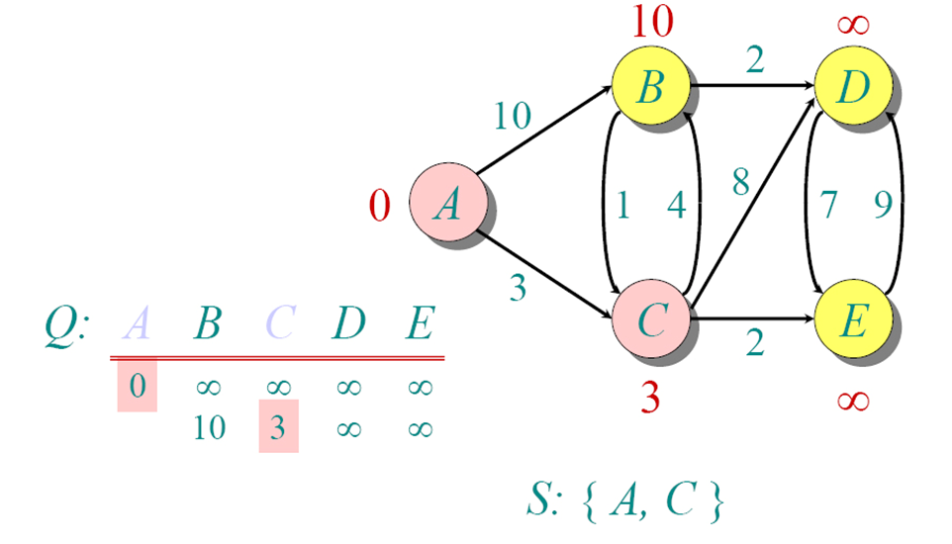
Dijkstra Animated Example

Slide 26
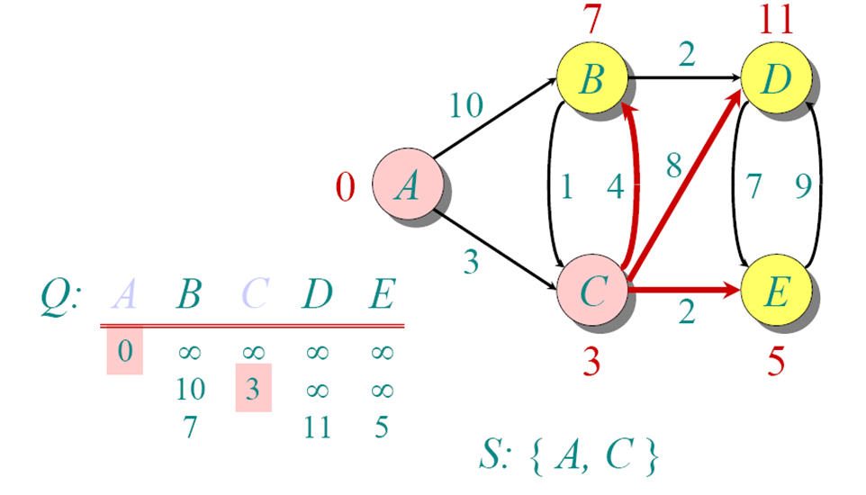
Dijkstra Animated Example

Slide 27
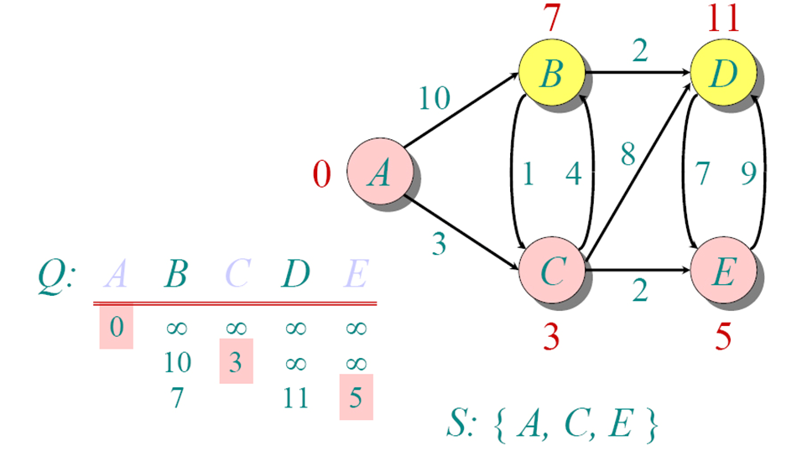
Dijkstra Animated Example

Slide 28
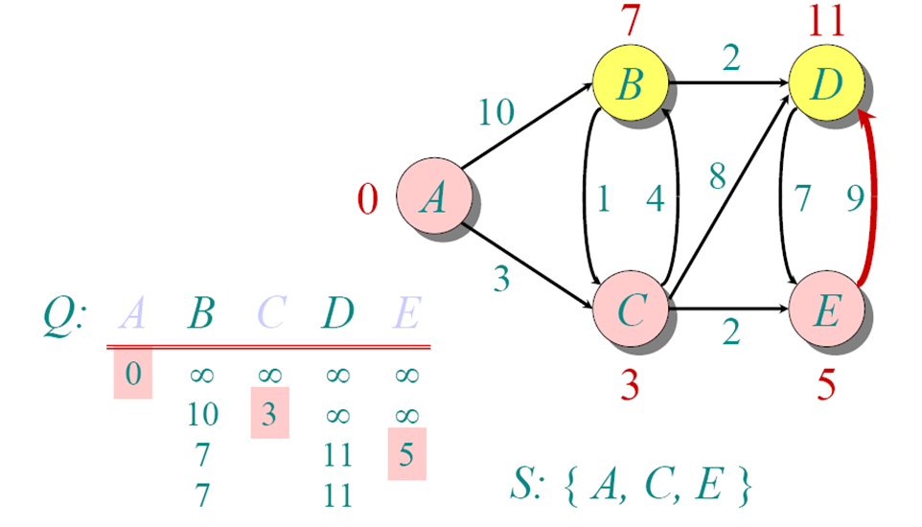
Dijkstra Animated Example

Slide 29
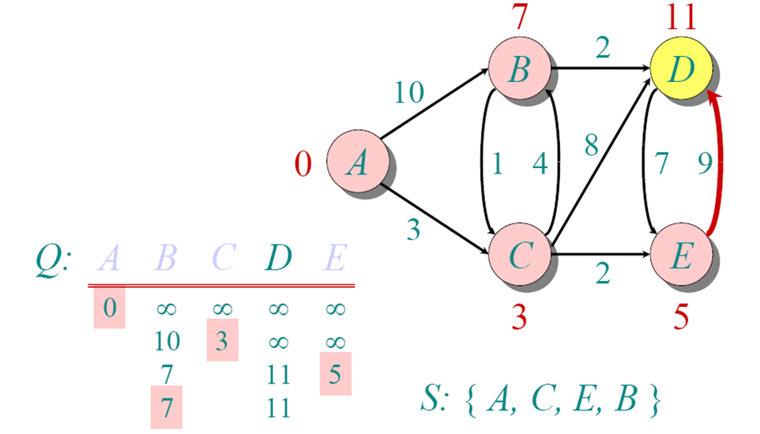
Dijkstra Animated Example

Slide 30
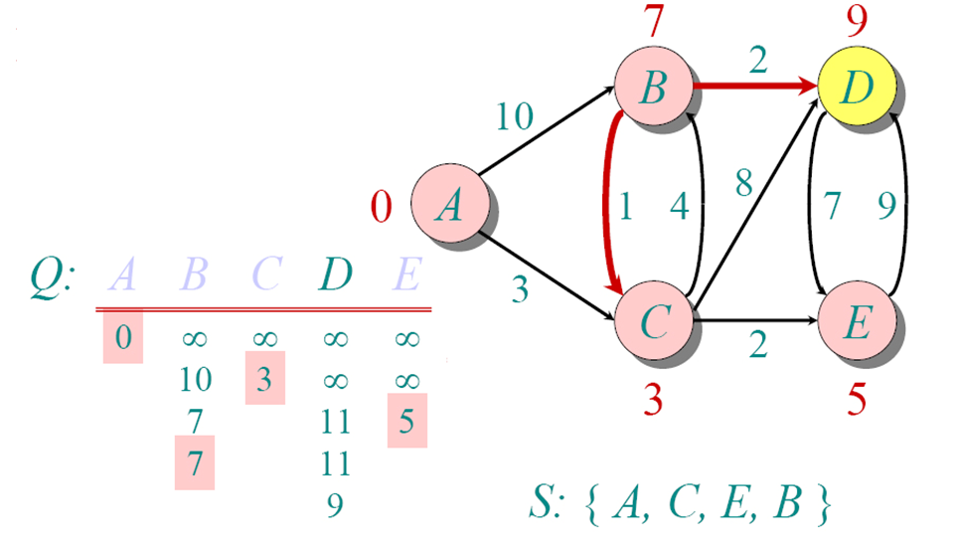
Dijkstra Animated Example

Slide 31
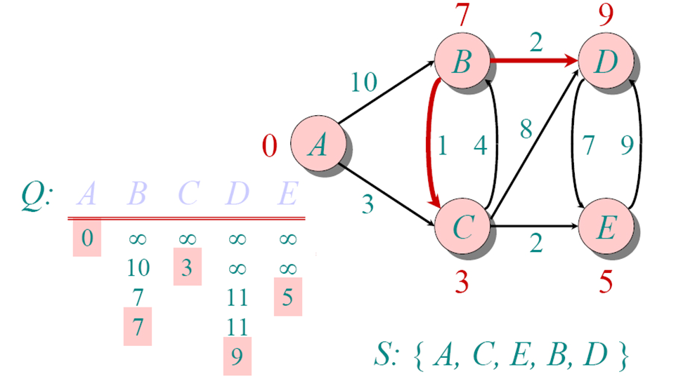
Dijkstra Animated Example

Slide 32
Implementations and Running Times
The simplest implementation is to store vertices in an array or linked list. This will produce a running time of
O(|V|^2 + |E|)
For sparse graphs, or graphs with very few edges and many nodes, it can be implemented more efficiently storing the graph in an adjacency list using a binary heap or priority queue. This will produce a running time of
O((|E|+|V|) log |V|)

Slide 33
Dijkstra's Algorithm - Why It Works
As with all greedy algorithms, we need to make sure that it is a correct algorithm (e.g., it always returns the right solution if it is given correct input).
A formal proof would take longer than this presentation, but we can understand how the argument works intuitively.
If you can’t sleep unless you see a proof, see the second reference or ask us where you can find it.

Slide 34
Dijkstra's Algorithm - Why It Works
To understand how it works, we’ll go over the previous example again. However, we need two mathematical results first:
Lemma 1: Triangle inequality If δ(u,v) is the shortest path length between u and v, δ(u,v) ≤ δ(u,x) + δ(x,v)
Lemma 2: The subpath of any shortest path is itself a shortest path.
The key is to understand why we can claim that anytime we put a new vertex in S, we can say that we already know the shortest path to it.
Now, back to the example…

Slide 35
Dijkstra's Algorithm - Why use it?
As mentioned, Dijkstra’s algorithm calculates the shortest path to every vertex.
However, it is about as computationally expensive to calculate the shortest path from vertex u to every vertex using Dijkstra’s as it is to calculate the shortest path to some particular vertex v.
Therefore, anytime we want to know the optimal path to some other vertex from a determined origin, we can use Dijkstra’s algorithm.

Slide 36
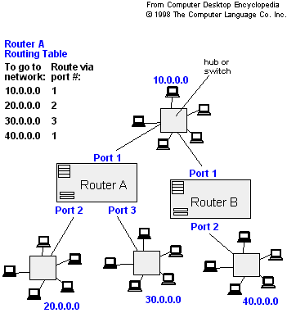
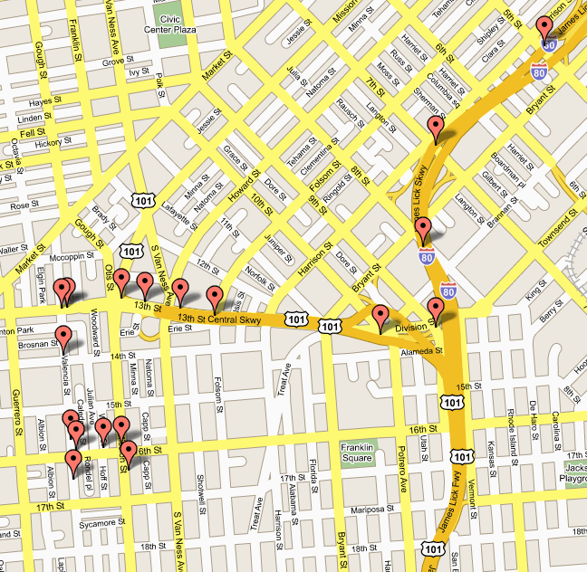
Applications of Dijkstra's Algorithm
- Traffic Information Systems are most prominent use
- Mapping (Map Quest, Google Maps)
- Routing Systems

Slide 37
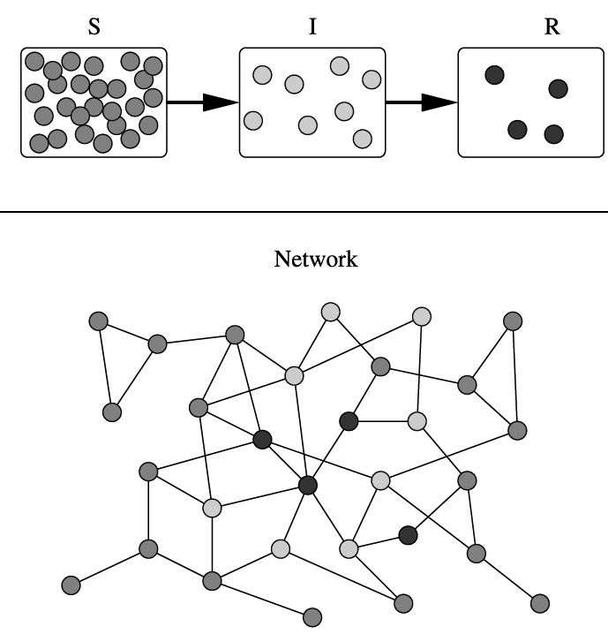
Applications of Dijkstra's Algorithm
One particularly relevant this week: epidemiology
Prof. Lauren Meyers (Biology Dept.) uses networks to model the spread of infectious diseases and design prevention and response strategies.
Vertices represent individuals, and edges their possible contacts. It is useful to calculate how a particular individual is connected to others.
Knowing the shortest path lengths to other individuals can be a relevant indicator of the potential of a particular individual to infect others.

Slide 38
References
Dijkstra’s original paper: E. W. Dijkstra. (1959) A Note on Two Problems in Connection with Graphs. Numerische Mathematik, 1. 269-271.
MIT OpenCourseware, 6.046J Introduction to Algorithms. < http://ocw.mit.edu/OcwWeb/Electrical-Engineering-and-Computer-Science/6-046JFall-2005/CourseHome/> Accessed 4/25/09
Meyers, L.A. (2007) Contact network epidemiology: Bond percolation applied to infectious disease prediction and control. Bulletin of the American Mathematical Society 44: 63-86.
Department of Mathematics, University of Melbourne. Dijkstra’s Algorithm. <http://www.ms.unimelb.edu.au/~moshe/620-261/dijkstra/dijkstra.html > Accessed 4/25/09

Slide 39
Module 06: Dynamic Programming

Slide 40
Module Outline:
Fundamentals of Dynamic programming based solution approach
0/1 Knapsack
Coinage problem
Shortest path using Floyd Warshall
Matrix Chain Multiplication
Longest common subsequence
Longest increasing sequence
String editing

Slide 41
Dynamic Programming (DP)
Like divide-and-conquer, solve problem by combining the solutions to sub-problems.
Differences between divide-and-conquer and DP:
Independent sub-problems, solve sub-problems independently and recursively, (so same sub(sub)problems solved repeatedly)
Sub-problems are dependent, i.e., sub-problems share sub-sub-problems, every sub(sub)problem solved just once, solutions to sub(sub)problems are stored in a table and used for solving higher level sub-problems.
Differences between Greedy and DP :
Greedy method have a local choice of the sub-problems whereas DP would solve the all sub-problems and then select one that would lead to an optimal solution i.e., at every step we take a decision(principle of optimality)

Slide 42
Example:
Definition of Fibonacci series for n:
F(n) = F(n-1) + F(n-2), with F(0) = F(1) = 1.
The first several are:
1, 1, 2, 3, 5, 8, 13, 21, 34, 55, 89, 144,…
Question:
Given n, what is F(n)?

Slide 43
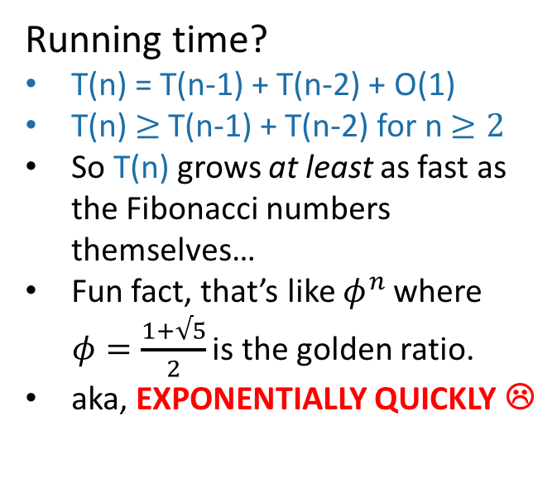
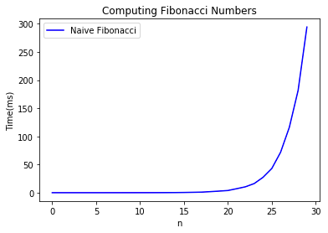
Candidate algorithm
See CLRS Problem 4-4 for a walkthrough of how fast the Fibonacci numbers grow!
def Fibonacci(n):
if n == 0 or n == 1:
return 1
return Fibonacci(n-1) + Fibonacci(n-2)

Slide 44
What’s going on? Consider Fib(8)
That’s a lot of repeated computation!
8
6
7
4
5
5
6
2
3
3
4
3
4
4
5
0
1
1
2
1
2
2
3
1
2
2
3
2
3
3
4
1
2
2
etc
0
1
0
1
0
1
1
2
0
1
0
1
0
1
1
1
2
0
1
0
1
0
1
0
1

Slide 45
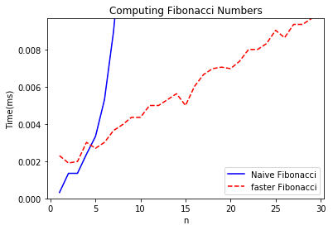
Maybe this would be better:
8
def fasterFibonacci(n):
F = [1, 1, None, None, …, None ]
\\ F has length n + 1
for i = 2, …, n:
F[i] = F[i-1] + F[i-2]
return F[n]
7
6
Much better running time!
5
4
3
2
1
0

Slide 46
Properties of DP:
1. Optimal sub-structure: Optimal solutions to sub-problems can be used to find the optimal solution of the original problem.
Ex: Fibonacci: F(i) for i≤n, F(i+1) = F(i)+ F(i -1)
2. Overlapping sub-problems: The subproblems show up again and again
Ex: Fibonacci: Both F[i+1] and F[i+2] directly use F[i] and lots of different F[i+x] indirectly use F[i].

Slide 47
Typical steps of DP
Characterize the structure of an optimal solution.
Recursively define the value of an optimal solution.
Compute the value of an optimal solution.
Compute an optimal solution from computed/stored information.

Slide 48
Implementation
Two ways to implement a DP solution:
Top-down approach
Bottom-up approach

Slide 49
Top-down approach
Think of it like a recursive algorithm.
To solve the big problem:
Recurs to solve smaller problems
Those recurs to solve smaller problems
etc..
Ex: Fibonacci series , we make recursive calls on n and then start exploring for the smaller values.

Slide 50
Bottom-up approach
For Fibonacci:
Solve the small problems first
fill in F[0],F[1]
Then bigger problems
fill in F[2]
Then bigger problems
fill in F[n-1]
Then finally solve the real problem.
fill in F[n]

Slide 51
Memorization
Idea:
Each entry in table initially contains a value indicating the entry has yet to be filled in.
When a subproblem is first encountered, its solution needs to be solved and then is stored in the corresponding entry of the table.
If the subproblem is encountered again in the future, just look up the table to take the value.

Slide 52
0/1 Knapsack Problem

Slide 53
0-1 Knapsack problem
Given a knapsack with maximum capacity W, and a set S consisting of n items
Each item i has some weight wi and benefit value bi (all wi , bi and W are integer values)
Problem: How to pack the knapsack to achieve maximum total value of packed items?

Slide 54
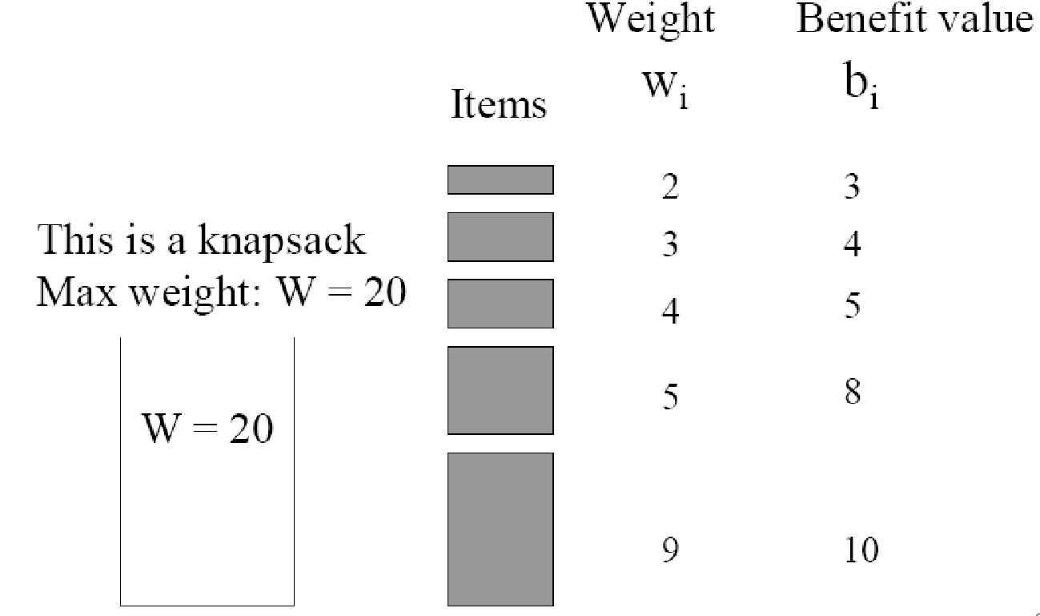
0-1 Knapsack problem: a picture

Slide 55
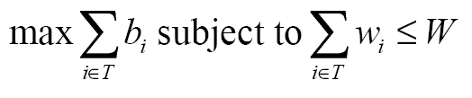
0/1 Knapsack Problem
Optimization criteria is to maximize the benefit value while maintaining the knapsack weight less than or equal to its capacity

Slide 56
0/1 Knapsack Problem Brute-force approach
The naive method is to consider all 2^{n} possible subsets of the n objects and choose the one that fits into the knapsack and maximizes the profit.
Running time will be O(2^{n})

Slide 57
Optimal Substructure of 0/1 Knapsack problem
If items are labeled 1..n, then a subproblem would be to find an optimal solution for Sk = {items labeled 1, 2, .. k}

Slide 58
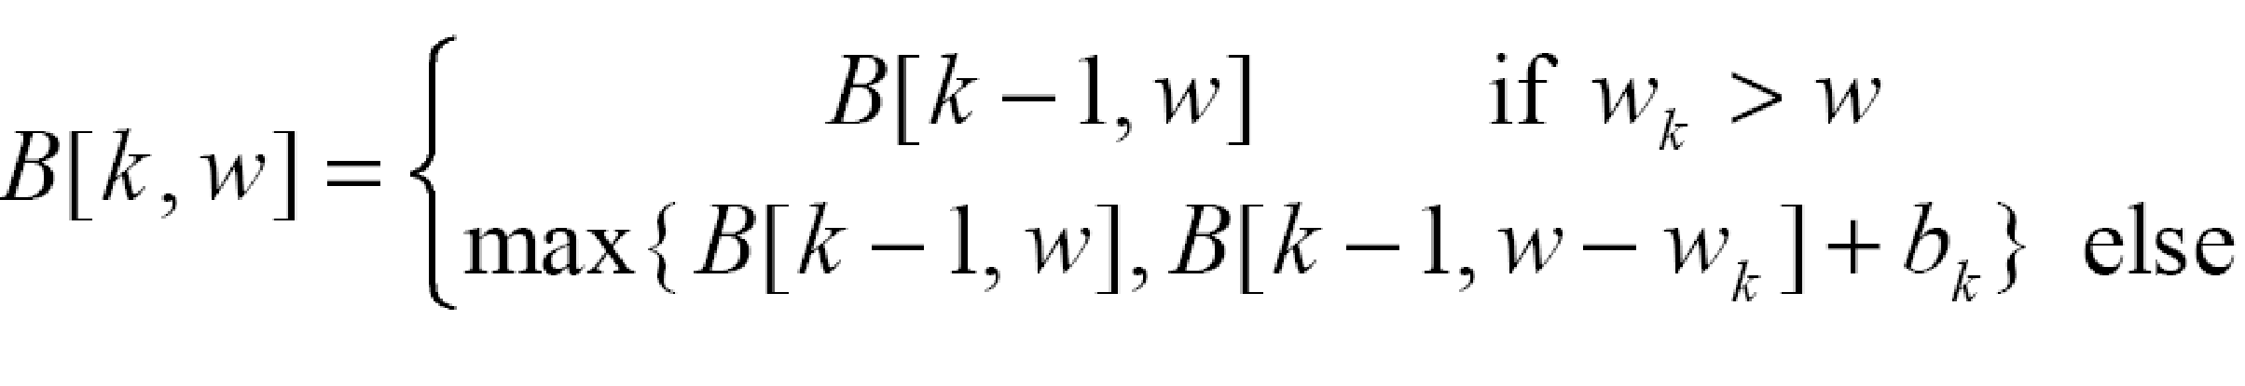
Recursive Formula for subproblems
Recursive formula for subproblems:
It means, that the best subset of Sk that has total
weight w is:
the best subset of Sk-1 that has total weight w, or
the best subset of Sk-1 that has total weight w-wk plus the item k

Slide 59
Recursive Formula for subproblems
The best subset of Sk that has the total weight w, either contains item k or not.
First case: wk>w. Item k can’t be part of the solution, since if it was, the total weight would be > w, which is unacceptable.
Second case: wk <= w. Then the item k can be in the solution, and we choose the case with greater value.

Slide 60
0-1 Knapsack Algorithm
for w = 0 to W
B[0,w] = 0
for i = 1 to n
B[i,0] = 0
for i = 1 to n
for w = 0 to W
if wi <= w // item i can be part of the solution
if bi + B[i-1,w-wi] > B[i-1,w]
B[i,w] = bi + B[i-1,w- wi]
else
B[i,w] = B[i-1,w]
else B[i,w] = B[i-1,w] // wi > w
running time of this algorithm = O(W*n)

Slide 61
Example
Let’s run our algorithm on the
following data:
n = 4 (# of elements)
W = 5 (max weight)
Elements (weight, benefit):
(2,3), (3,4), (4,5), (5,6)

Slide 62
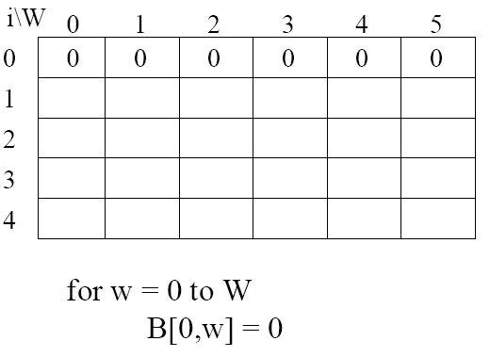
Elements (weight, benefit): (2,3), (3,4), (4,5), (5,6)

Slide 63
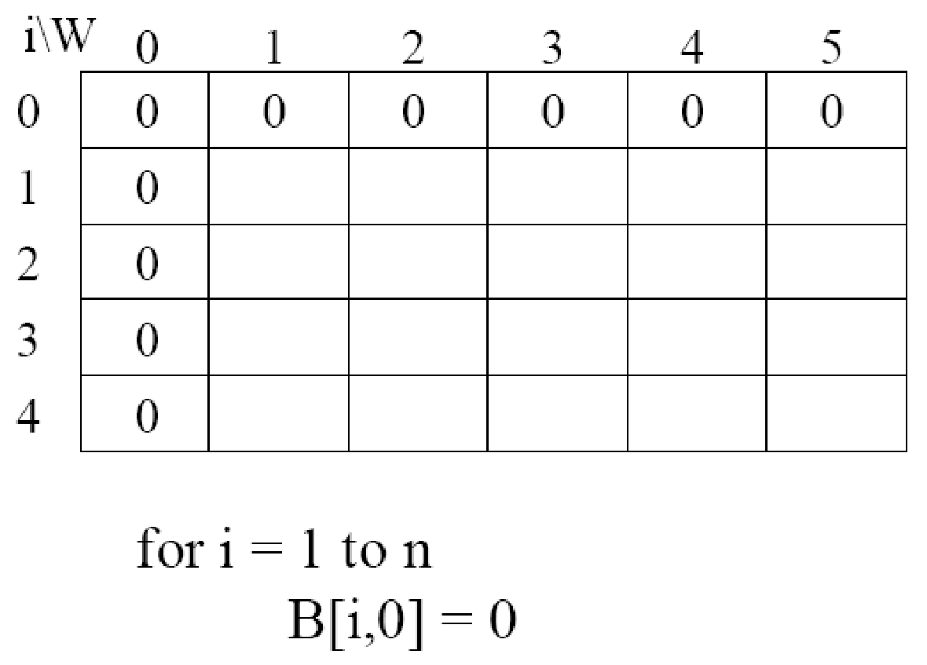
Elements (weight, benefit): (2,3), (3,4), (4,5), (5,6)

Slide 64
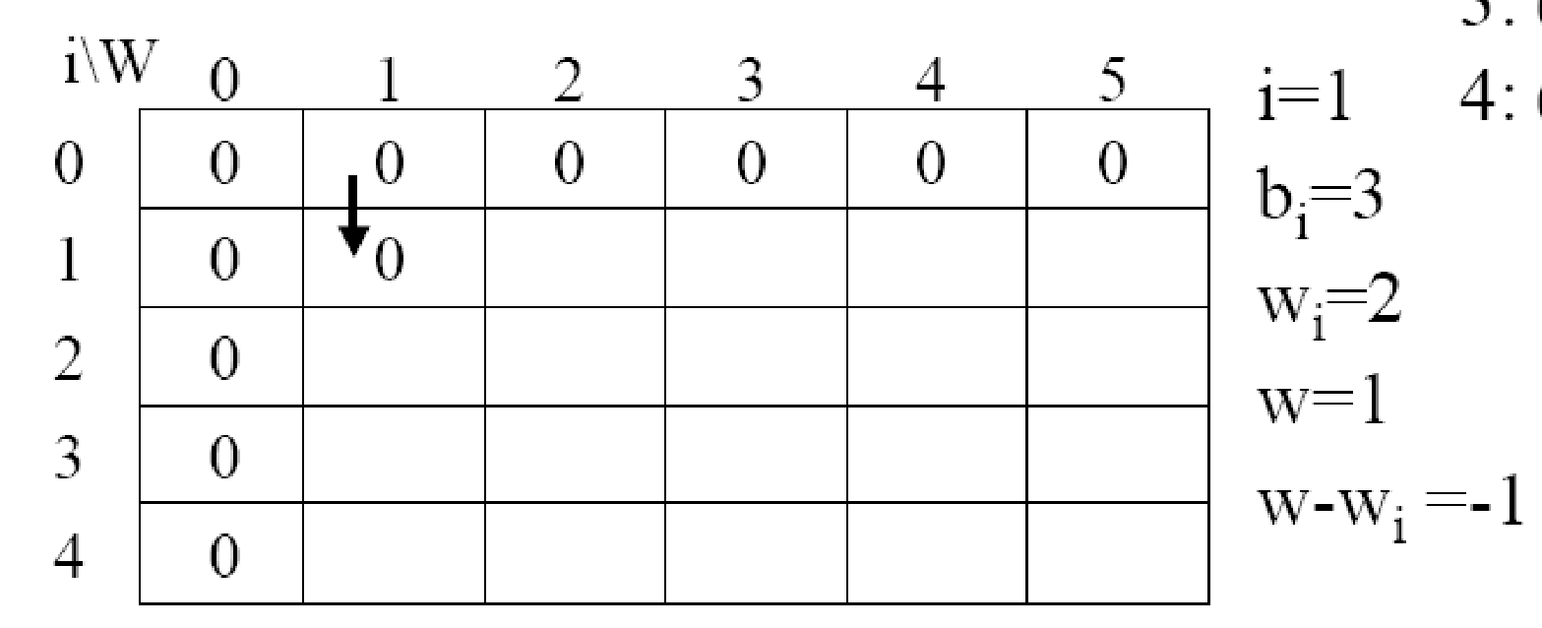
Elements (weight, benefit): (2,3), (3,4), (4,5), (5,6)

Slide 65
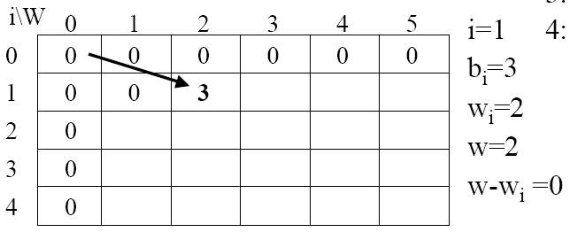
Elements (weight, benefit): (2,3), (3,4), (4,5), (5,6)

Slide 66
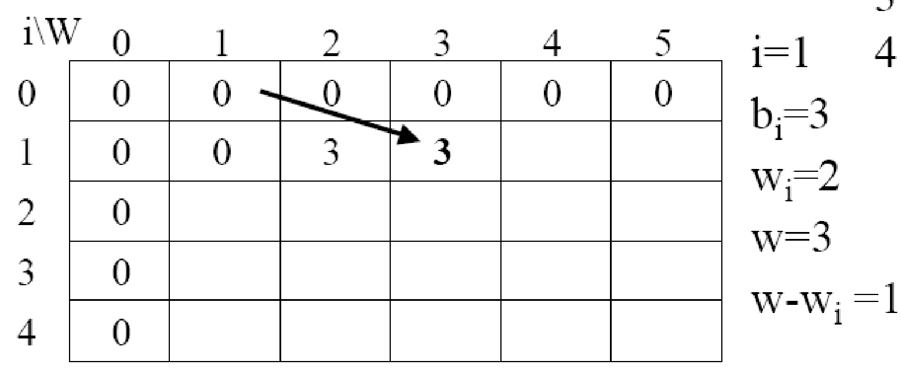
Elements (weight, benefit): (2,3), (3,4), (4,5), (5,6)

Slide 67
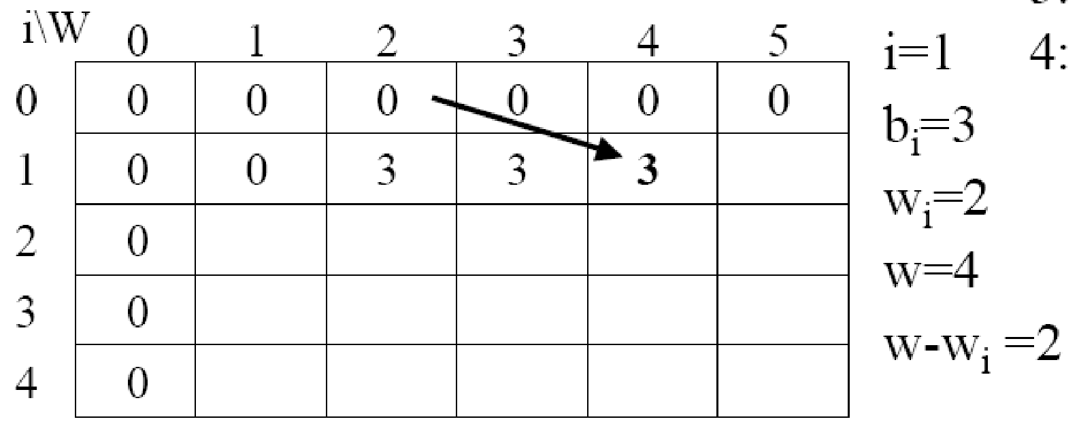
Elements (weight, benefit): (2,3), (3,4), (4,5), (5,6)

Slide 68
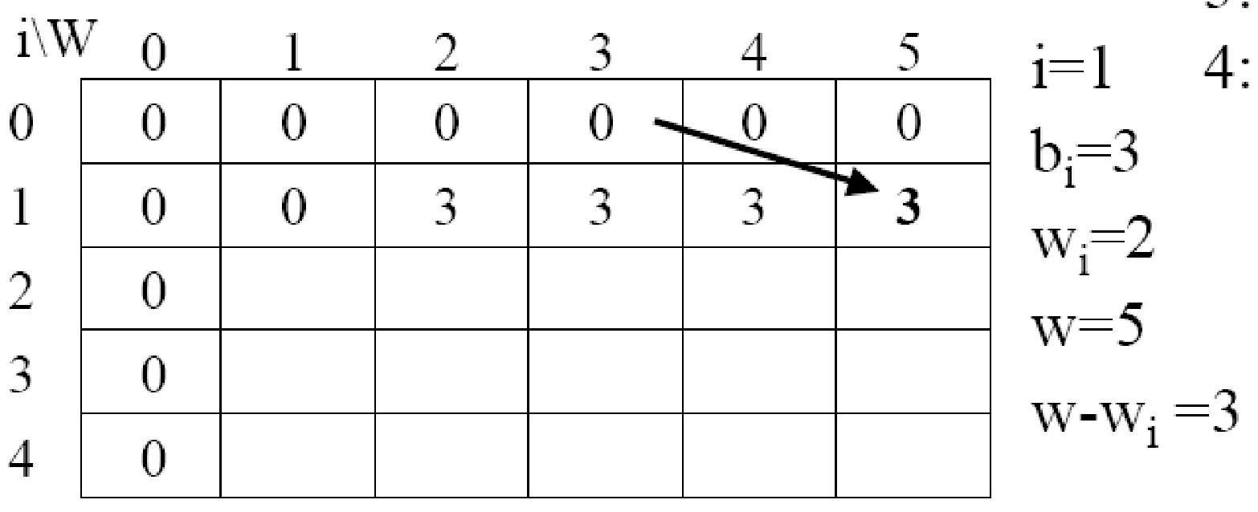
Elements (weight, benefit): (2,3), (3,4), (4,5), (5,6)

Slide 69
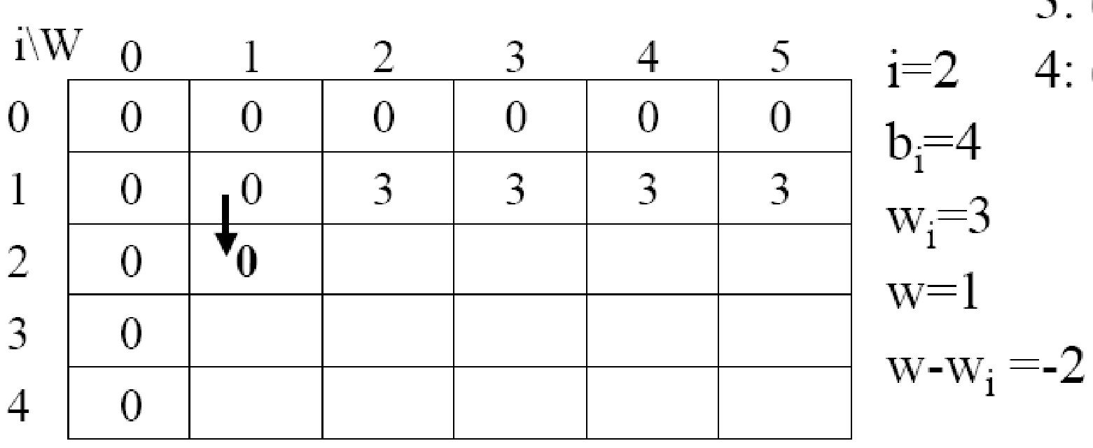
Elements (weight, benefit): (2,3), (3,4), (4,5), (5,6)

Slide 70
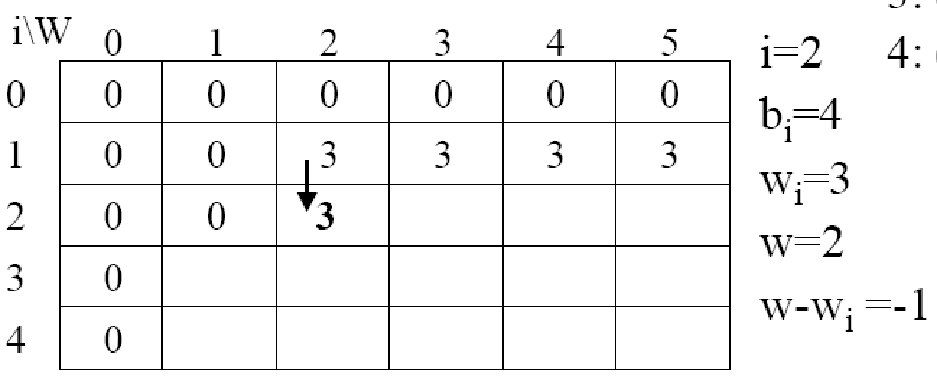
Elements (weight, benefit): (2,3), (3,4), (4,5), (5,6)

Slide 71
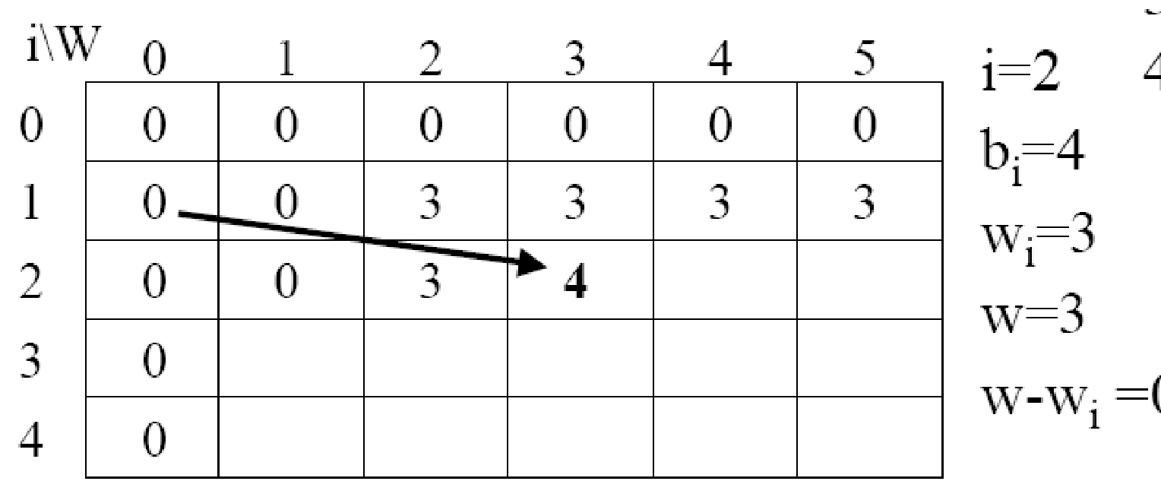
Elements (weight, benefit): (2,3), (3,4), (4,5), (5,6)
0

Slide 72
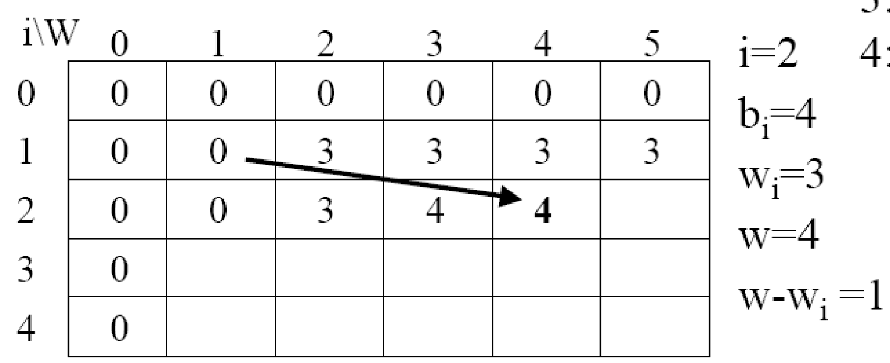
Elements (weight, benefit): (2,3), (3,4), (4,5), (5,6)

Slide 73
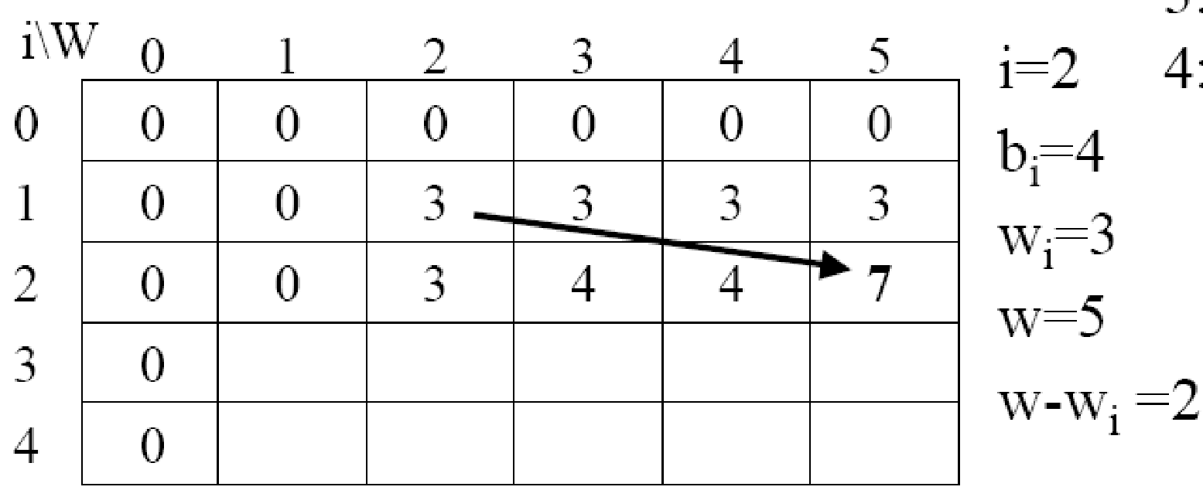
Elements (weight, benefit): (2,3), (3,4), (4,5), (5,6)

Slide 74
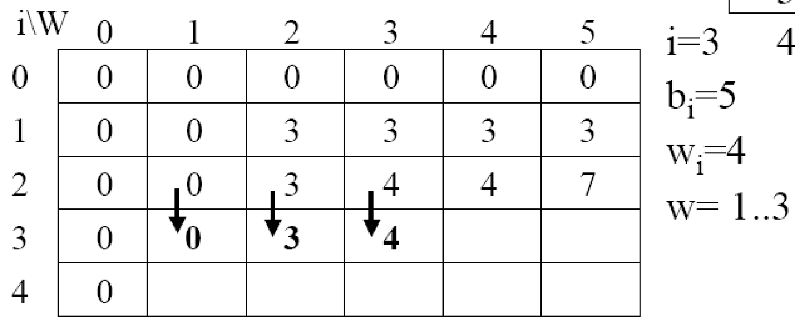
Elements (weight, benefit): (2,3), (3,4), (4,5), (5,6)

Slide 75
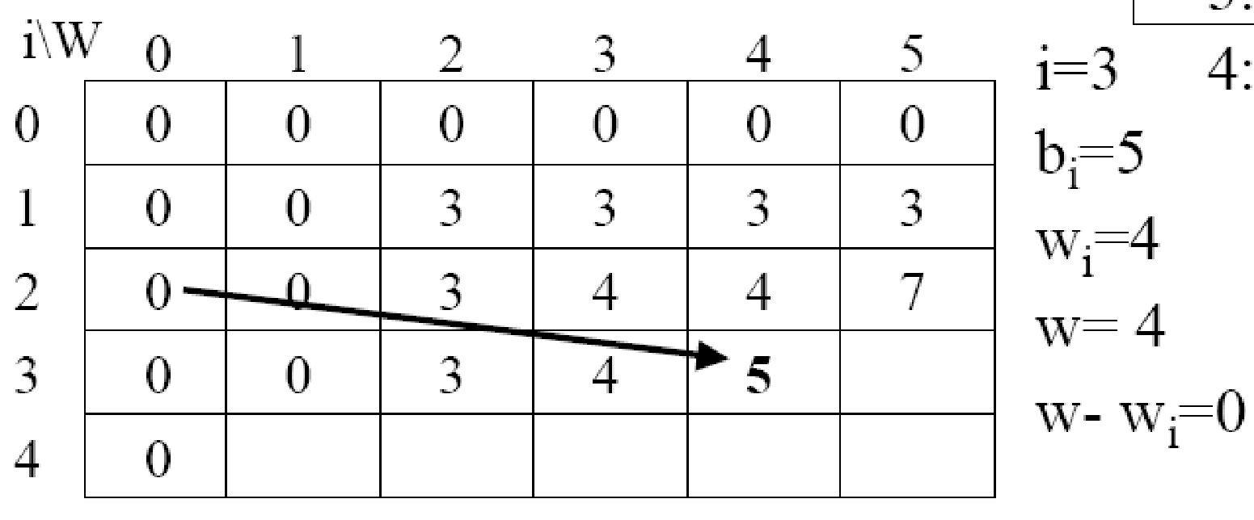
Elements (weight, benefit): (2,3), (3,4), (4,5), (5,6)

Slide 76
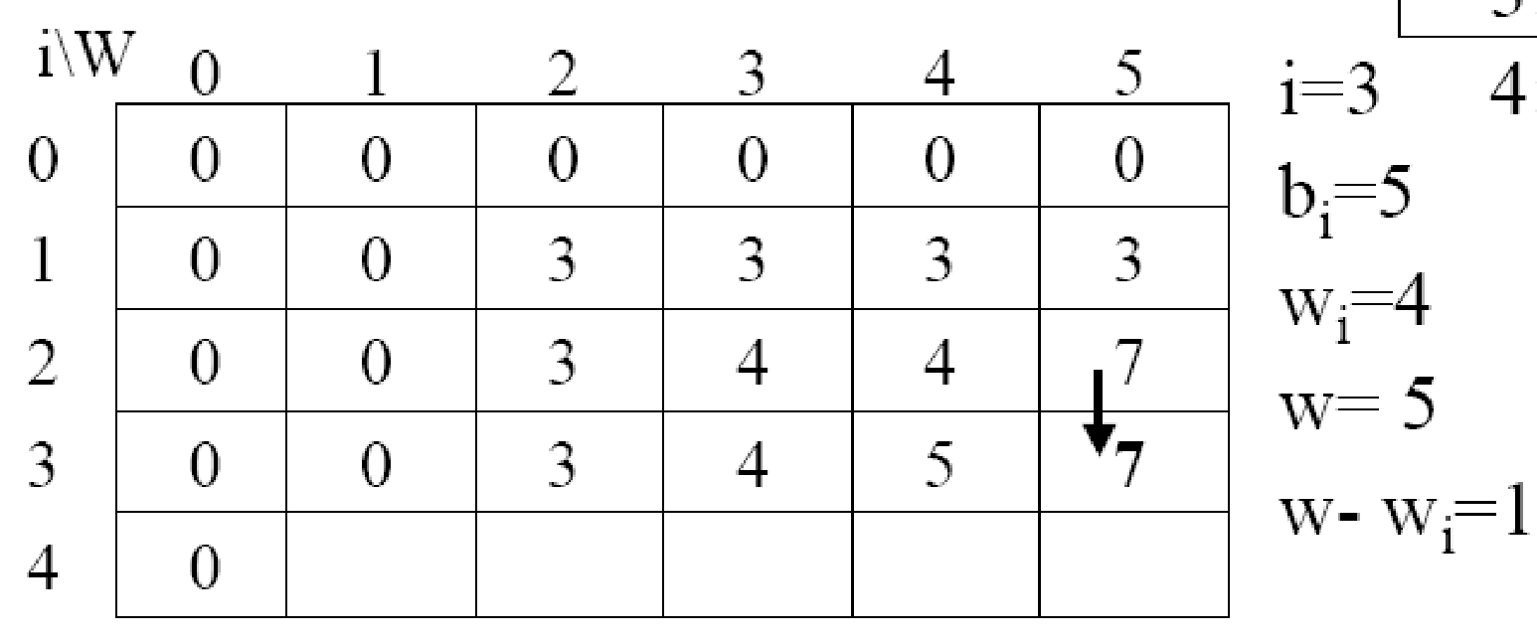
Elements (weight, benefit): (2,3), (3,4), (4,5), (5,6)

Slide 77
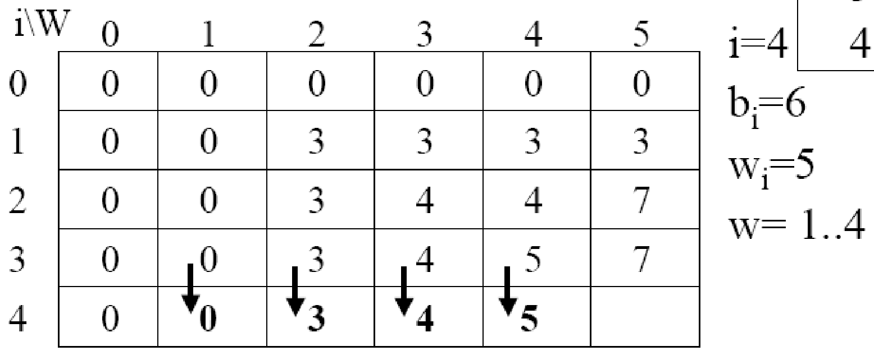
Elements (weight, benefit): (2,3), (3,4), (4,5), (5,6)

Slide 78
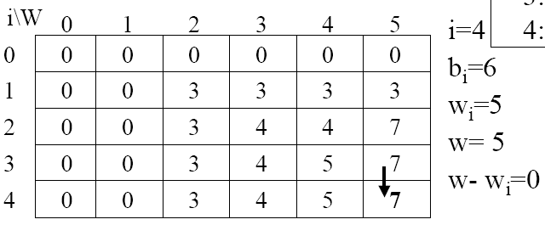
Elements (weight, benefit): (2,3), (3,4), (4,5), (5,6)

Slide 79
Finding the Items
Let i=n and k=W
if B[i,k] != B[i-1,k] then
mark the ith item as in the knapsack
i = i -1,
k = k - wi
else
i = i -1 // Assume the ith item is not in the knapsack

Slide 80
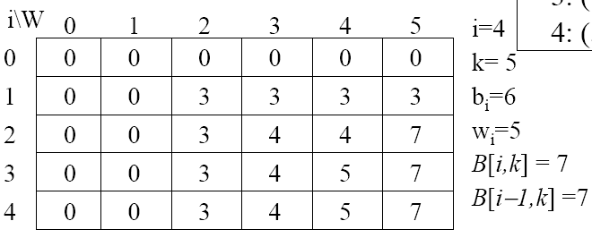
Finding the Items

Slide 81
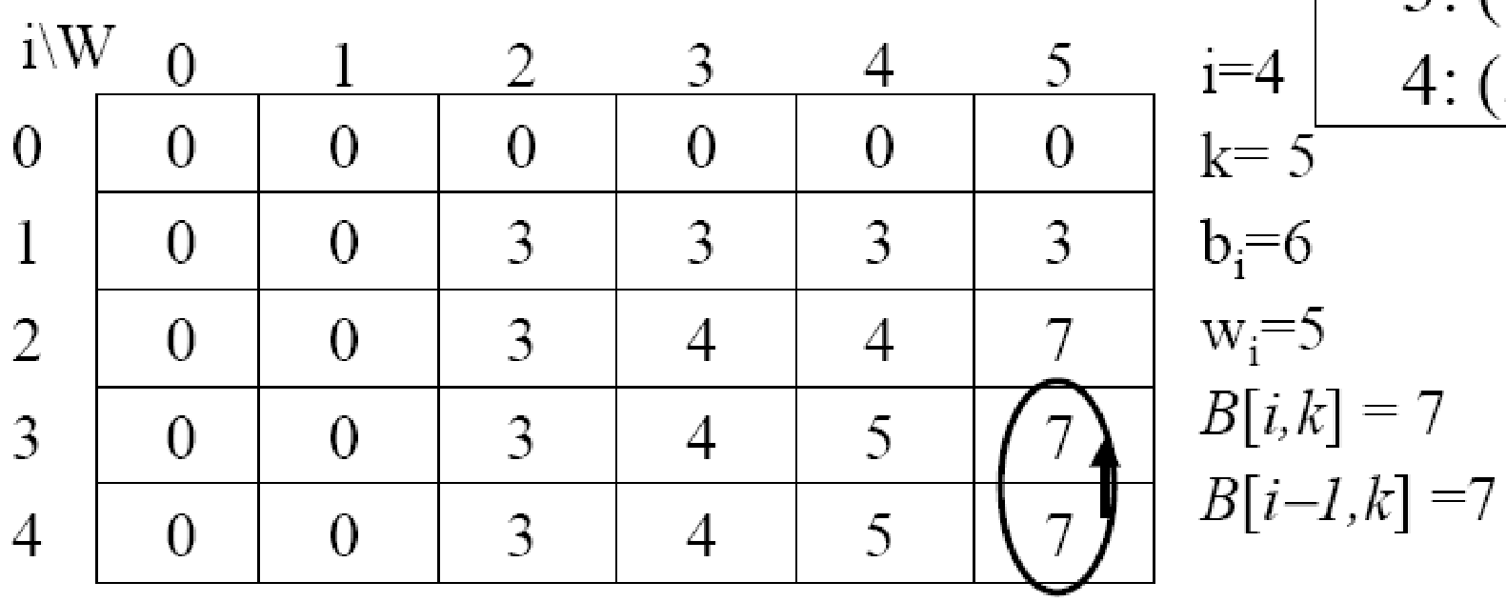
Finding the Items

Slide 82
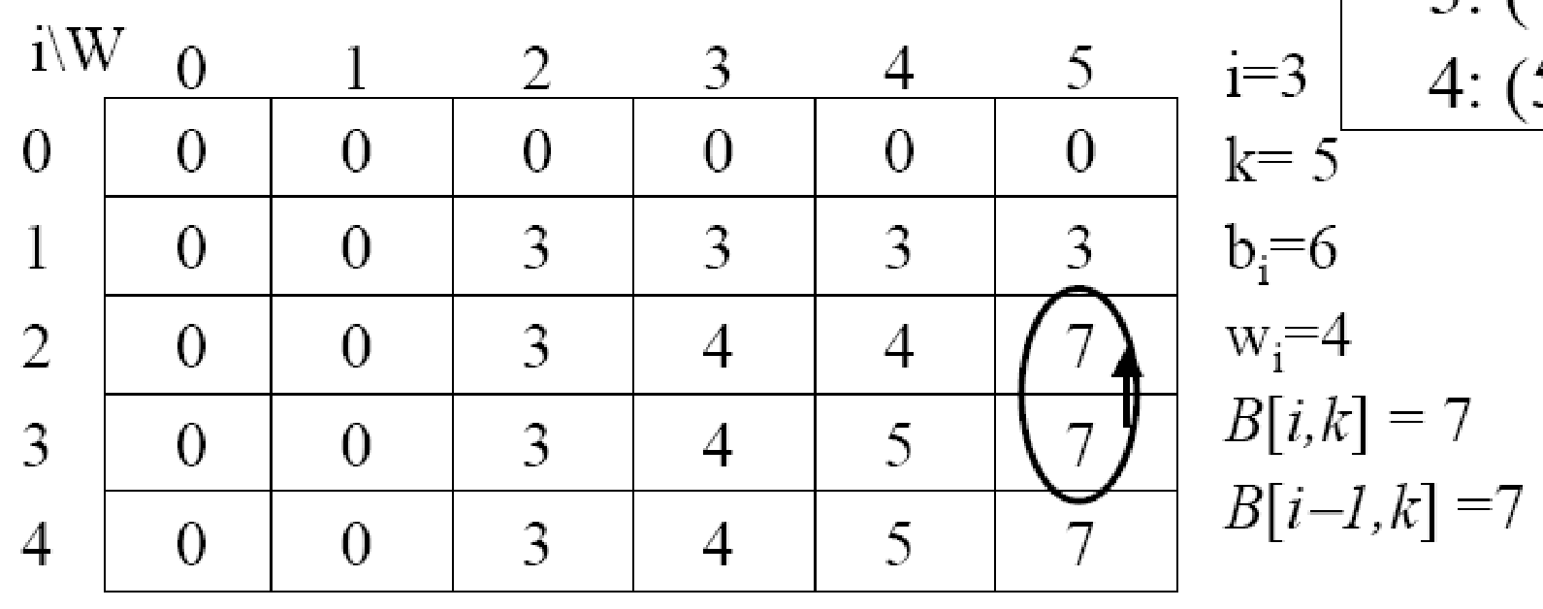
Finding the Items

Slide 83
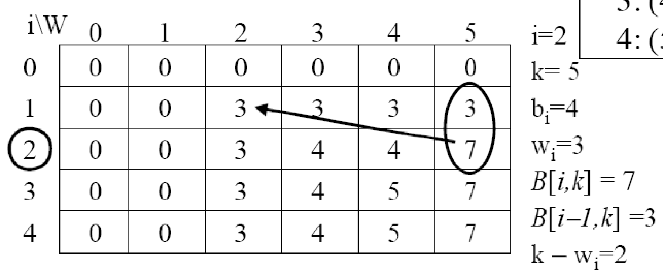
Finding the Items
if B[i,k] != B[i-1,k] then
mark the ith item as in the knapsack
i = i -1,
k = k - wi

Slide 84
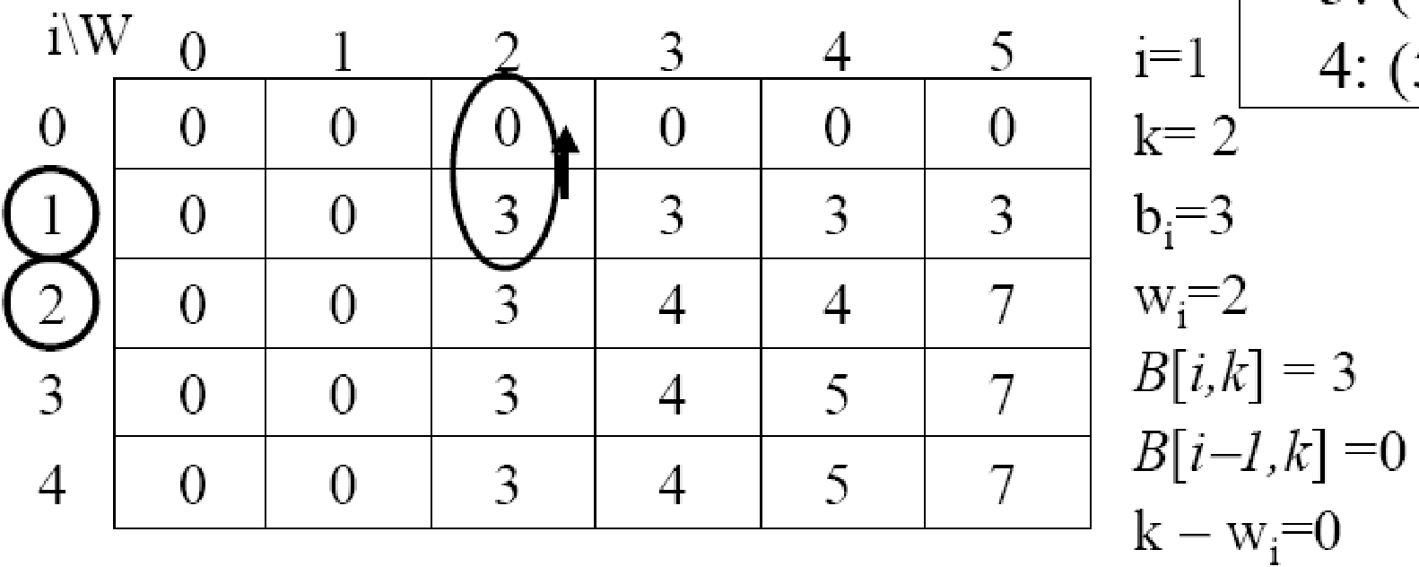
Finding the Items
if B[i,k] != B[i-1,k] then
mark the ith item as in the knapsack
i = i -1,
k = k - wi

Slide 85
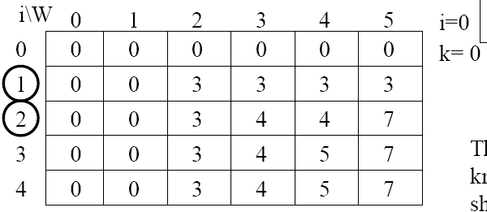
Finding the Items

Slide 86
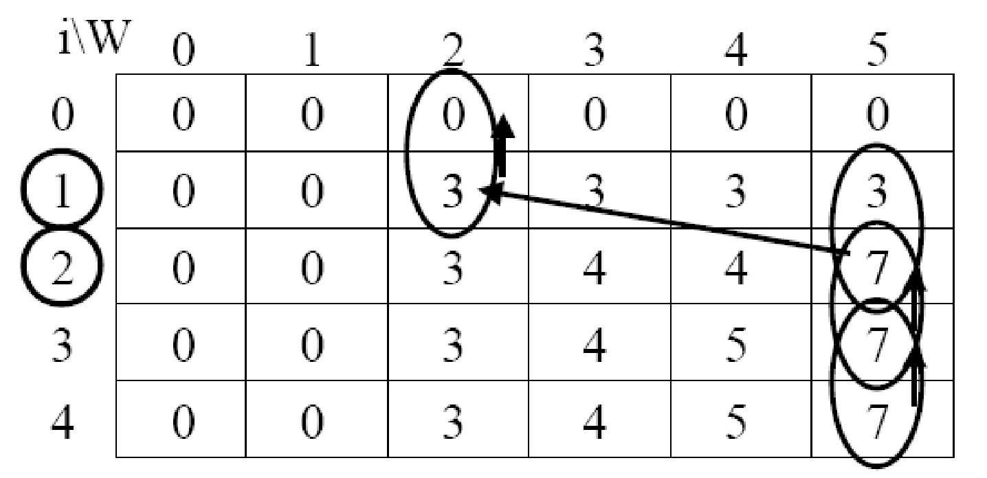
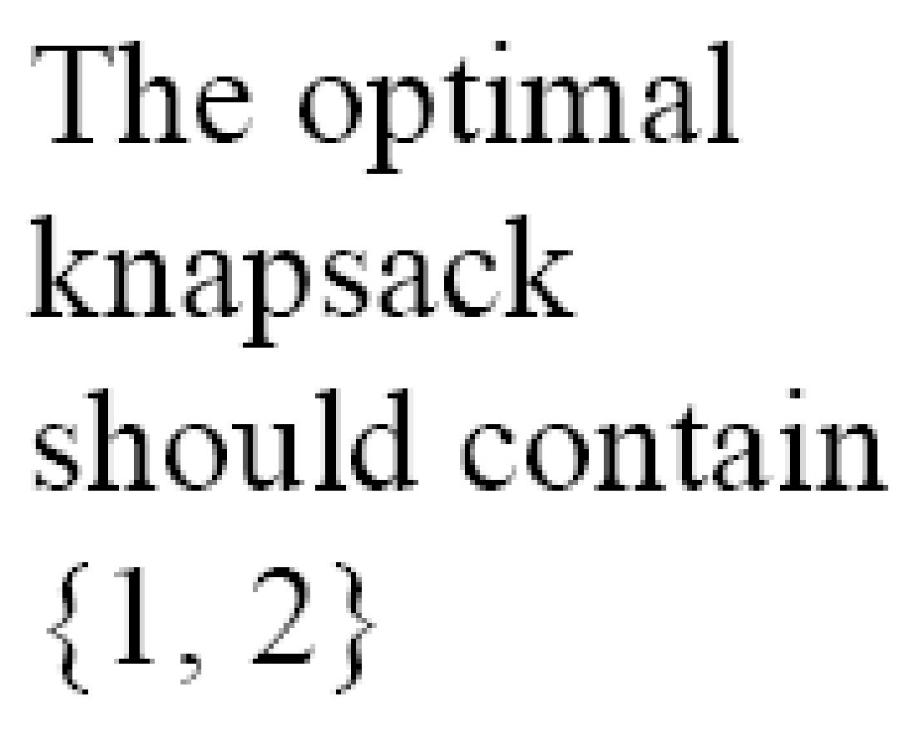
Finding the Items

Slide 87
All pairs shortest path
The problem: find the shortest path between every pair of vertices of a graph
The graph: may contain negative edges but no negative cycles
A representation: a weight matrix where W(i,j)=0 if i=j. W(i,j)=∞ if there is no edge between i and j. W(i,j)=“weight of edge”
Note: we have shown principle of optimality applies to shortest path problems

Slide 88
The subproblems
Let D^{(k)}[i,j]=weight of a shortest path from v_{i} to v_{j} using only vertices from {v₁,v₂,…,v_{k}} as intermediate vertices in the path
D⁽⁰⁾=W
D^{(n)}=D which is the goal matrix
How do we compute D^{(k)} from D^{(k-1)} ?

Slide 89
The Recursive Definition:
Case 1: A shortest path from v_{i} to v_{j} restricted to using only vertices from {v₁,v₂,…,v_{k}} as intermediate vertices does not use v_{k}.
Then D^{(k)}[i,j]= D^{(k-1)}[i,j]. Case 2: A shortest path from v_{i} to v_{j} restricted to using only vertices from {v₁,v₂,…,v_{k}} as intermediate vertices does use v_{k}.
Then D^{(k)}[i,j]= D^{(k-1)}[i,k]+ D^{(k-1)}[k,j].
Shortest path using intermediate vertices {V₁, . . . V_{k} }
V_{k}
V_{j}
V_{i}
Shortest Path using intermediate vertices { V_{1, . . .} V_{k -1} }

Slide 90
The recursive definition
Since D^{(k)}[i,j]= D^{(k-1)}[i,j] or D^{(k)}[i,j]= D^{(k-1)}[i,k]+ D^{(k-1)}[k,j]. We conclude: D^{(k)}[i,j]= min{ D^{(k-1)}[i,j], D^{(k-1)}[i,k]+ D^{(k-1)}[k,j] }.
Shortest path using intermediate vertices {V₁, . . . V_{k} }
V_{k}
V_{j}
V_{i}
Shortest Path using intermediate vertices { V_{1, . . .} V_{k -1} }

Slide 91
The pointer array P
Used to enable finding a shortest path
Initially the array contains 0
Each time that a shorter path from i to j is found the k that provided the minimum is saved (highest index node on the path from i to j)
To print the intermediate nodes on the shortest path a recursive procedure that print the shortest paths from i and k, and from k to j can be used

Slide 92
Floyd's Algorithm Using n+1 D matrices
Floyd//Computes shortest distance between all pairs of //nodes, and saves P to enable finding shortest paths 1. D⁰ ← W // initialize D array to W [ ] 2. P ← 0 // initialize P array to [0] 3. for k ← 1 to n 4. do for i ← 1 to n 5. do for j ← 1 to n 6. if (D^{k-1}[ i, j ] > D^{k-1} [ i, k ] + D^{k-1} [ k, j ] ) 7. then D^{k}[ i, j ] ← D^{k-1} [ i, k ] + D^{k-1} [ k, j ] 8. P[ i, j ] ← k; 9. else D^{k}[ i, j ] ← D^{k-1} [ i, j ]

Slide 93
Example
1
2
3
1
0
4
5
W = D⁰ =
1
2
2
0
∞
5
3
∞
-3
0
4
2
3
1
2
3
2
-3
1
0
0
0
P =
2
0
0
0
3
0
0
0

Slide 94
k = 1 Vertex 1 can be intermediate node
1
1
2
3
5
D⁰ =
1
0
4
5
4
2
3
2
2
0
∞
2
-3
3
∞
-3
0
1
2
3
1
0
4
5
D¹[2,3] = min( D⁰[2,3], D⁰[2,1]+D⁰[1,3] )
= min (∝, 7)
= 7
D¹[3,2] = min( D⁰[3,2], D⁰[3,1]+D⁰[1,2] )
= min (-3,∝)
= -3
D¹ =
2
2
0
7
3
∞
-3
0
1
2
3
1
0
0
0
P =
2
0
0
1
3
0
0
0

Slide 95
k = 2 Vertices 1, 2 can be intermediate
1
2
3
1
5
D¹ =
1
0
4
5
4
2
3
2
2
0
7
2
-3
3
∞
-3
0
1
2
3
1
0
4
5
D²[1,3] = min( D¹[1,3], D¹[1,2]+D¹[2,3] )
= min (5, 4+7)
= 5
D²[3,1] = min( D¹[3,1], D¹[3,2]+D¹[2,1] )
= min (∝, -3+2)
= -1
D² =
2
2
0
7
3
-1
-3
0
1
2
3
1
0
0
0
P =
2
0
0
1
3
2
0
0

Slide 96
k = 3 Vertices 1, 2, 3 can be intermediate
1
1
2
3
5
D² =
1
0
4
5
3
4
2
2
2
0
7
2
-3
3
-1
-3
0
1
2
3
1
0
2
5
D³ =
D³[1,2] = min(D²[1,2], D²[1,3]+D²[3,2] )
= min (4, 5+(-3))
= 2
D³[2,1] = min(D²[2,1], D²[2,3]+D²[3,1] )
= min (2, 7+ (-1))
= 2
2
2
0
7
3
-1
-3
0
1
2
3
1
0
3
0
P =
2
0
0
1
3
2
0
0

Slide 97
Longest Common Subsequence (LCS)
DNA analysis, two DNA string comparison.
DNA string: a sequence of symbols A,C,G,T.
S=ACCGGTCGAGCTTCGAAT
Subsequence (of X): is X with some symbols left out.
Z=CGTC is a subsequence of X=ACGCTAC.
Common subsequence Z (of X and Y): a subsequence of X and also a subsequence of Y.
Z=CGA is a common subsequence of both X=ACGCTAC and Y=CTGACA.
Longest Common Subsequence (LCS): the longest one of common subsequences.
Z' =CGCA is the LCS of the above X and Y.
LCS problem: given X=<x₁, x₂,…, x_{m}> and Y=<y₁, y₂,…, y_{n}>, find their LCS.

Slide 98
LCS Intuitive Solution –brute force
List all possible subsequences of X, check whether they are also subsequences of Y, keep the longer one each time.
Each subsequence corresponds to a subset of the indices {1,2,…,m}, there are 2^{m}. So exponential.

Slide 99
LCS DP –step 1: Optimal Substructure
Characterize optimal substructure of LCS.
Theorem 15.1: Let X=<x₁, x₂,…, x_{m}> (= X_{m}) and Y=<y₁, y₂,…,y_{n}> (= Y_{n}) and Z=<z₁, z₂,…, z_{k}> (= Z_{k}) be any LCS of X and Y,
1. if x_{m}= y_{n}, then z_{k}= x_{m}= y_{n}, and Z_{k-1} is the LCS of X_{m-1} and Y_{n-1}.
2. if x_{m}≠ y_{n}, then z_{k} ≠ x_{m} implies Z is the LCS of X_{m-1} and Y_{n}.
3. if x_{m}≠ y_{n}, then z_{k} ≠ y_{n} implies Z is the LCS of X_{m} and Y_{n-1}.

Slide 100
LCS DP –step 2:Recursive Solution
What the theorem says:
If x_{m}= y_{n,} find LCS of X_{m-1} and Y_{n-1}, then append x_{m}.
If x_{m} ≠ y_{n,} find LCS of X_{m-1} and Y_{n} and LCS of X_{m} and Y_{n-1}, take which one is longer.
Overlapping substructure:
Both LCS of X_{m-1} and Y_{n} and LCS of X_{m} and Y_{n-1} will need to solve LCS of X_{m-1} and Y_{n-1}.
c[i,j] is the length of LCS of X_{i} and Y_{j} .
c[i,j]= 0 if i=0, or j=0
c[i-1,j-1]+1 if i,j>0 and x_{i}= y_{j,}
max{c[i-1,j], c[i,j-1]} if i,j>0 and x_{i} ≠ y_{j,}

Slide 101
LCS DP-- step 3:Computing the Length of LCS
c[0..m,0..n], where c[i,j] is defined as above.
c[m,n] is the answer (length of LCS).
b[1..m,1..n], where b[i,j] points to the table entry corresponding to the optimal subproblem solution chosen when computing c[i,j].
From b[m,n] backward to find the LCS.

Slide 102
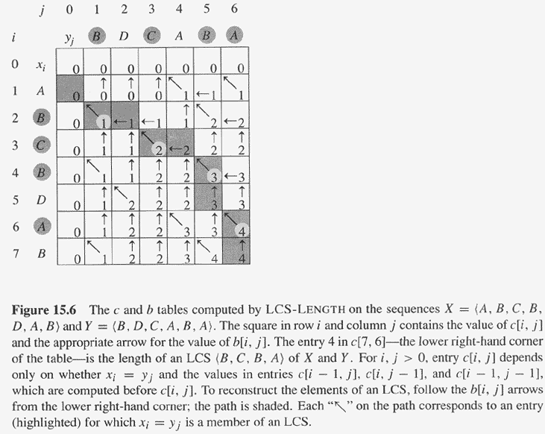
LCS computation example

Slide 103
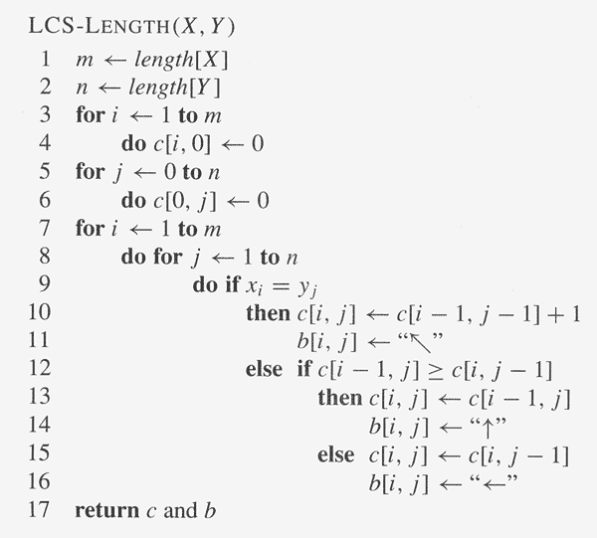
LCS DP Algorithm

Slide 104
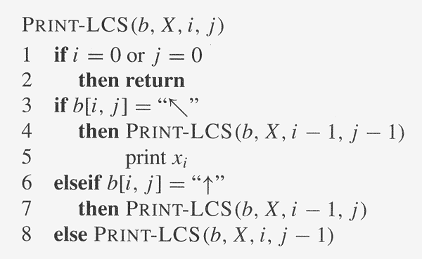
LCS DP –step 4: Constructing LCS

Slide 105
LCS space saving version
Remove array b.
Print_LCS_without_b(c,X,i,j){
If (i=0 or j=0) return;
If (c[i,j]==c[i-1,j-1]+1)
{Print_LCS_without_b(c,X,i-1,j-1); print x_{i}}
else if(c[i,j]==c[i-1,j])
{Print_LCS_without_b(c,X,i-1,j);}
else
{Print_LCS_without_b(c,X,i,j-1);}
}

Slide 106
References
1. Introduction to Algorithms, 3rd Edition (The MIT Press) 3rd Edition
by Thomas H. Cormen, Charles E. Leiserson, Ronald L. Rivest , Clifford Stein
(Presented Examples and Pseudo codes are according to ref. 1)

